Slide 1
Ask Weber (Or get asked by Weber)
Session 2: 01-05-2020
Contents:
Lecture 4 – Lecture 6
Weber Liu

Slide 2
Lecture 4
4 hours after a meal, in what form is energy stored as within the body?

Slide 3
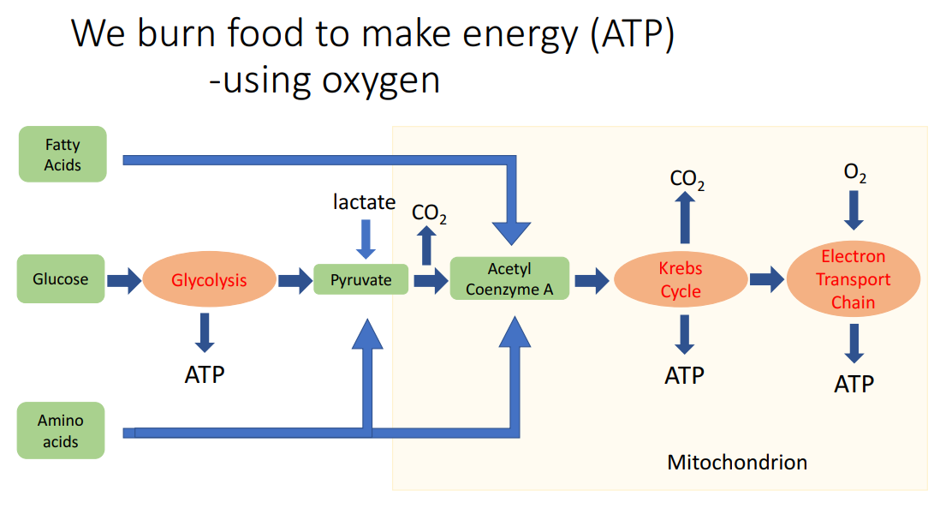
Lecture 4

Slide 4
Lecture 4
What physiological signs and symptoms occur when a type 1 diabetic injects too much insulin and experiences a hypoglycaemic attack?

Slide 5
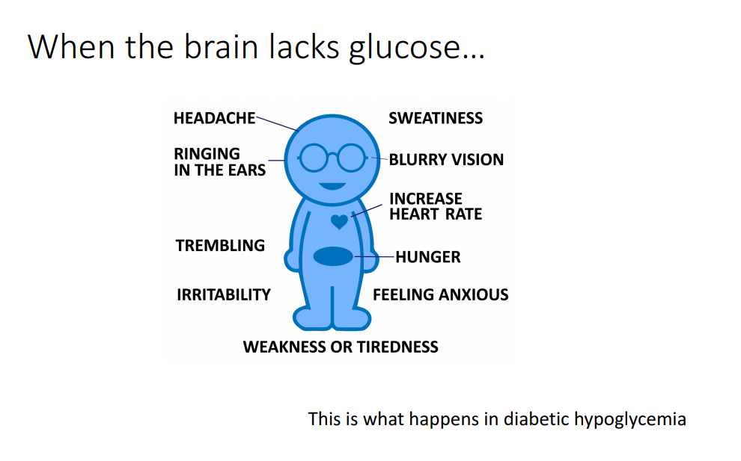
Lecture 4
What physiological signs and symptoms occur when a type 1 diabetic injects too much insulin and experiences a hypoglycaemic attack?

Slide 6
Lecture 5
What are the different blood vessels blood has to travel through to get from the L heart (around the body) and back to the R heart?
Which of these vessels have smooth muscle around them?
Supp Q: Explain the principle of the starling equation

Slide 7
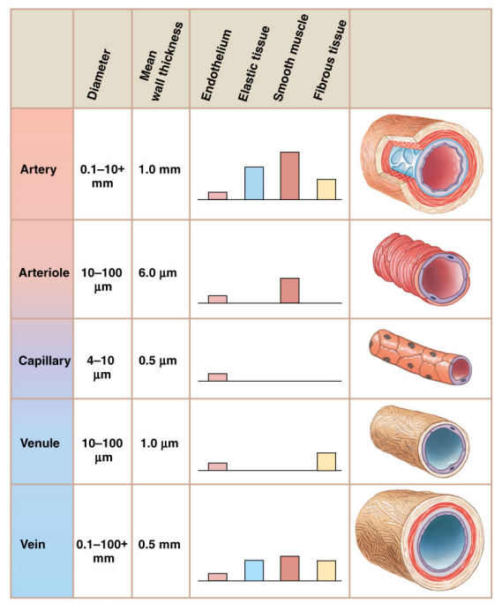
Lecture 5

Slide 8
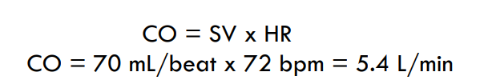
Lecture 5
Where are the pacemaker cells of the heart located?
SA node: right atrium
AV node:
Purkinje fibres in ventricles
Describe the electrical current pathways within the heart
The electrical signal starts in SA node down to AV node and AV bundle to the Purkinje fiber and then it spreads upward
Calculate the stroke volume of the heart given the cardiac output is 5.6L/min and heart rate is 80bpm.

Slide 9
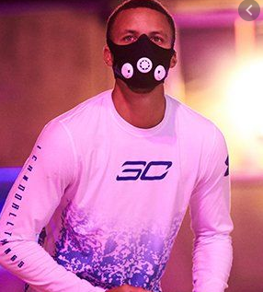
Lecture 5
Polycythaemia vera is a haematological condition characterised by excessive red blood cells – what is the glycoprotein responsible for increasing production of red blood cells in a normal state?
In a normal human, under what conditions would this glycoprotein be released?
What organ is this glycoprotein released from?

Slide 10
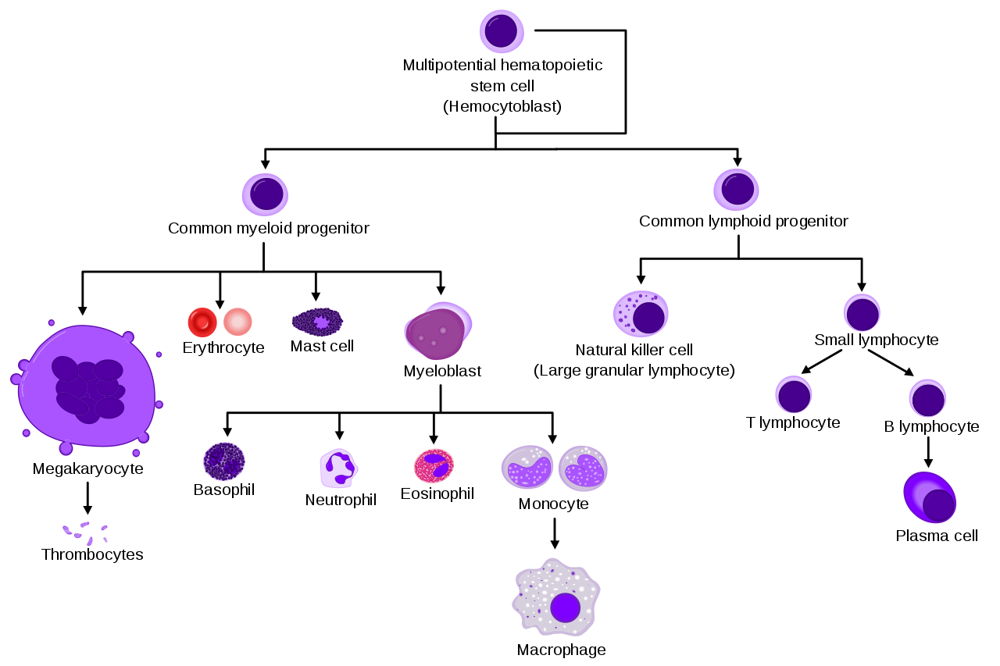

Slide 11
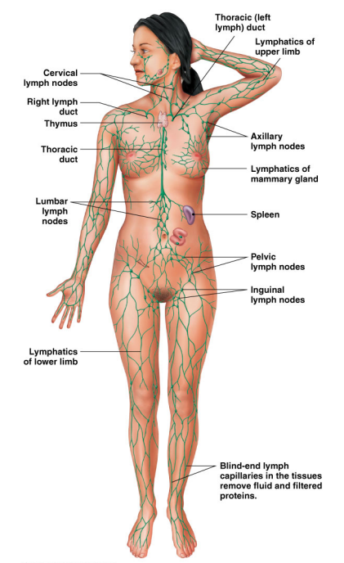
Lecture 5
When blood flows through a capillary, only approx. 80% of the fluid leaving the capillary from the arteriolar end will return at the venous end – how is the remainder of this fluid returned to circulation?
In some form of cancers (e.g. breast cancer), lymph nodes must be removed, and sentinel nodes checked to ensure no metastatic involvement of the tumour. What action will this play on fluid return?

Slide 12
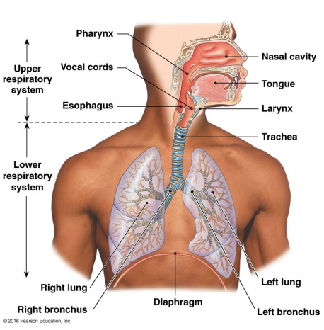
Lecture 6
How many lung lobes on the left lung? Right lung?
2 on left, 3 on right
What structure of the left lung is present due to the presence of the heart?
Lingula of the left lung
Which rib does the apex of the lung reach?
Above 1st rib
If you aspirate a tooth during a tooth extraction (at the dentist’s office), which lung is it likely to fall into?

Slide 13
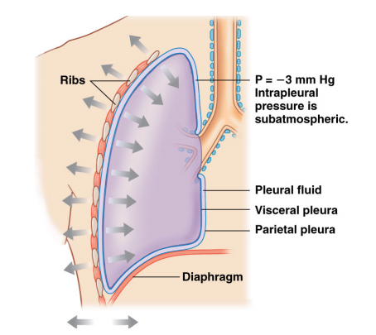
Lecture 6
What is the terminal structure of a lung?
How is a negative intrathoracic pressure generated during a breathing cycle?
Given that the inferior (and superior) vena cava are present as intrathoracic structures, how does the negative intrathoracic pressure affect the venous return to the heart?

Slide 14
Lecture 6
Is the visceral or the parietal pleura in contact with the lung surface?
In passive expiration, which muscles are required to contract? What kinds of intrathoracic pressures does this generate?

Slide 15
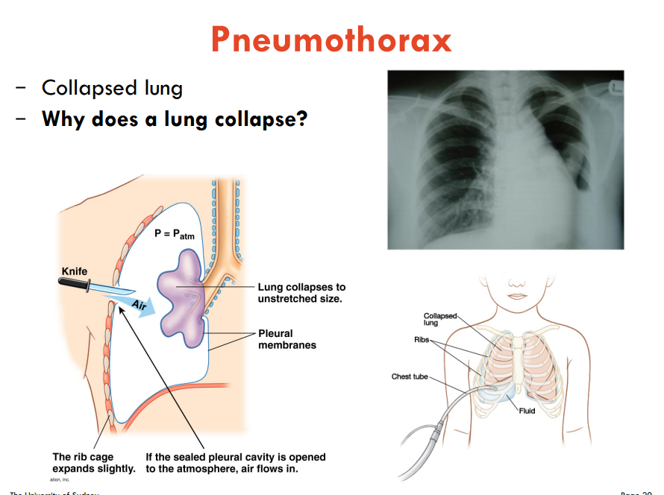
Lecture 6
A person is found with a stab wound through his right lateral chest wall between ribs 4 and 5. You observe a tracheal deviation to the left and resonance during percussion. You determine they have a tension pneumothorax. What is the mechanism of action for this? What is the immediate treatment for this, given they are hemodynamically stable?

